Slide 1
JPS+: Over 100x Faster than A* Steve Rabin Principal Lecturer DigiPen Institute of Technology

Slide 2
JPS+: Over 100x Faster than A* JPS+ now with Goal Bounding: Over 1000x Faster than A*

Slide 3
Slides: www.gameaipro.com

Slide 4

Coming out April 2015
…however, back in
June 2014…
…however,
2 months ago…

Slide 5
Two Primary Techniques (Node Pruning)
JPS+ (ICAPS July 2014)
“Avoid redundant paths on grids”
Goal Bounding (developed in Jan 2015)
“Avoid wrong directions on any kind of map”

Slide 6
Test Maps (movingai.com)
75 StarCraft maps (198,230 problems)
156 Dragon Age Origins maps (159,465 problems)
36 Warcraft III maps (50,971 problems)

Slide 7
Test Maps (movingai.com)
75 StarCraft maps (198,230 problems)
156 Dragon Age Origins maps (159,465 problems)
36 Warcraft III maps (50,971 problems)

Slide 8
A*
JPS+
JPS+ Goal Bounding

Slide 9
A*
JPS+
JPS+ Goal Bounding

Slide 10
A*
JPS+
JPS+ Goal Bounding

Slide 11
A*
JPS+
JPS+ Goal Bounding

Slide 12
A*
JPS+
JPS+ Goal Bounding

Slide 13
Goal Bounding
JPS+
70x to 350x
faster
1400x to 5000x
faster
20x to 60x
faster
Avoid
Redundant
Paths
Avoid
Wrong
Directions

Slide 14
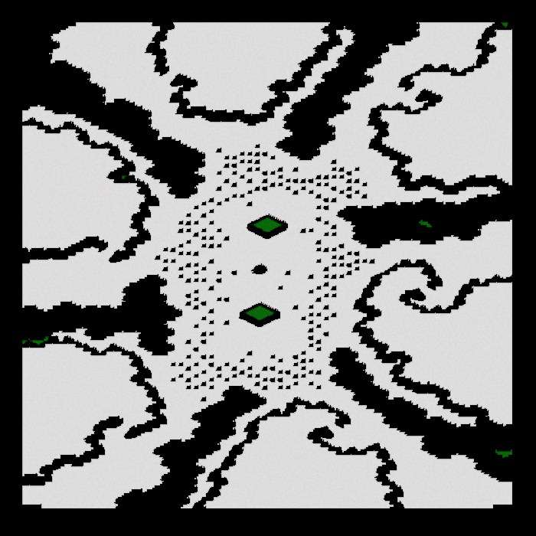
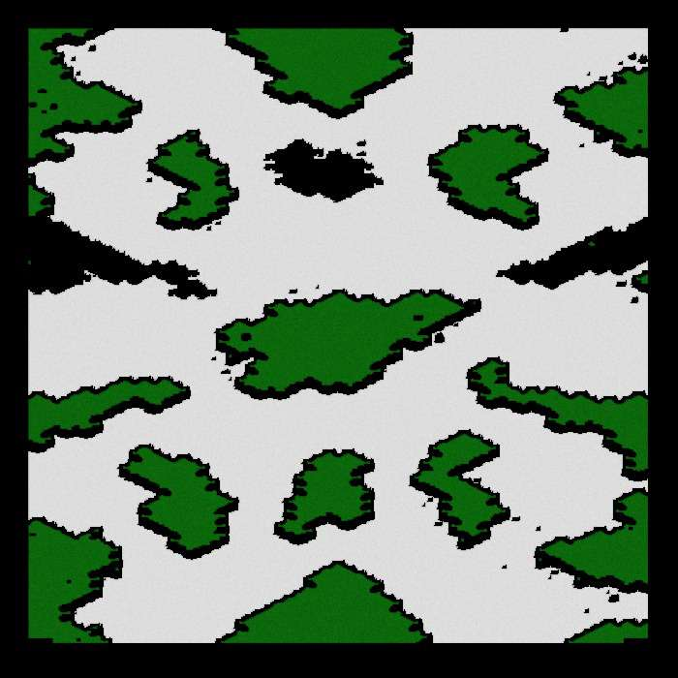
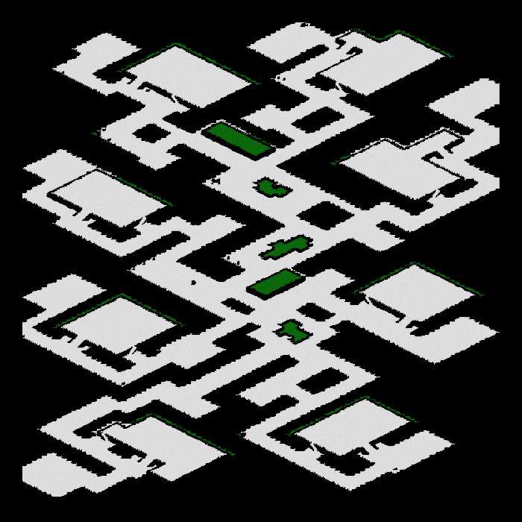
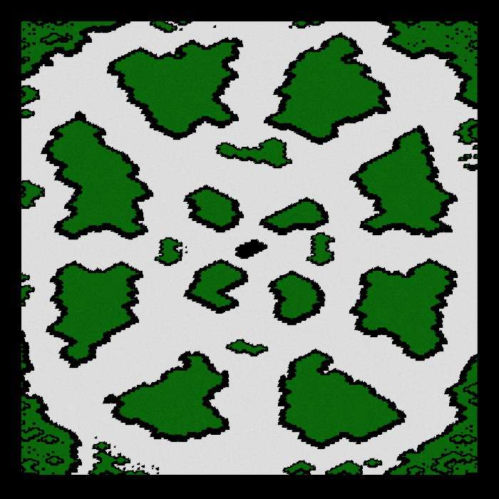
StarCraft Maps: JPS+

Slide 15
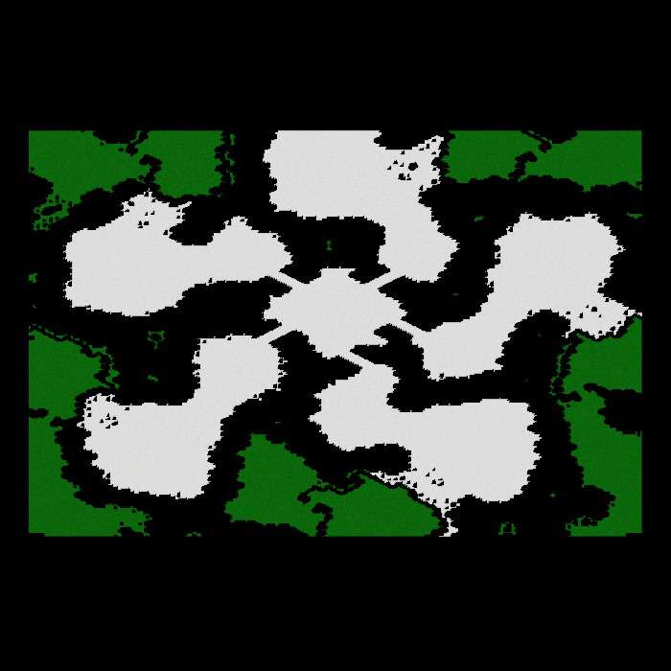
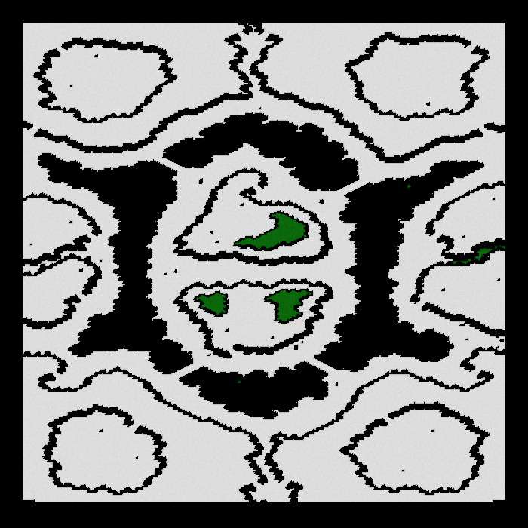
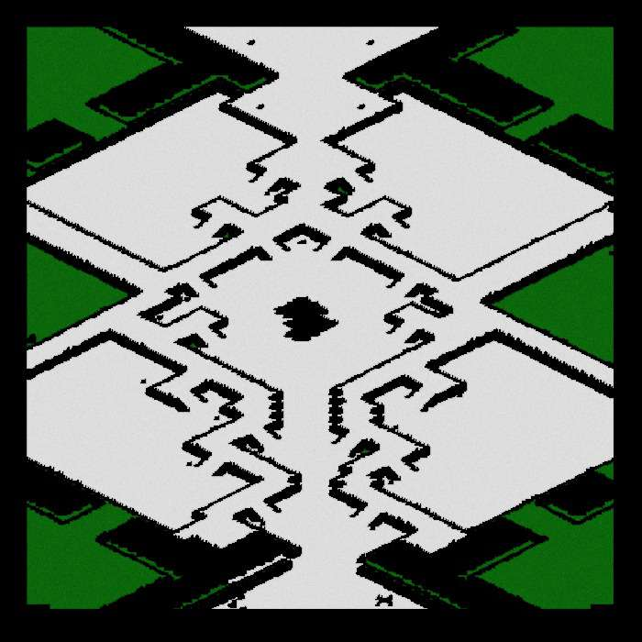
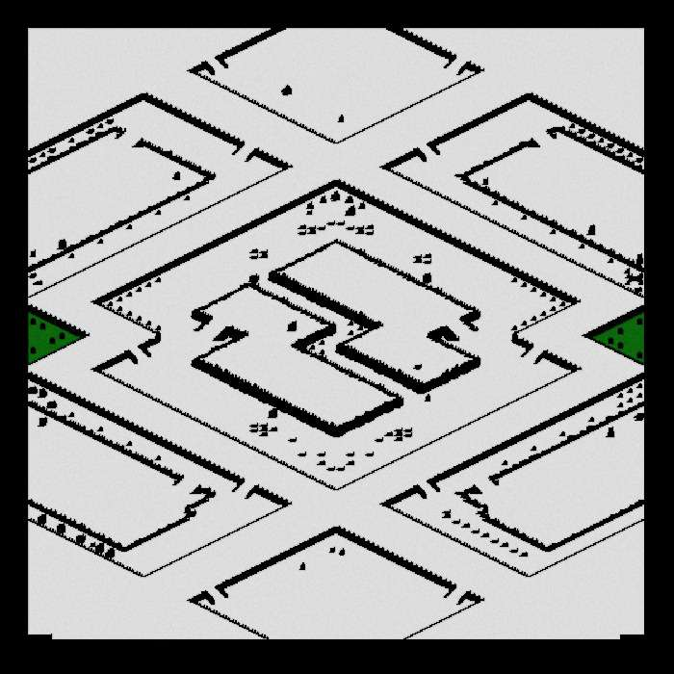
StarCraft Maps: Subgoal Graph

Slide 16
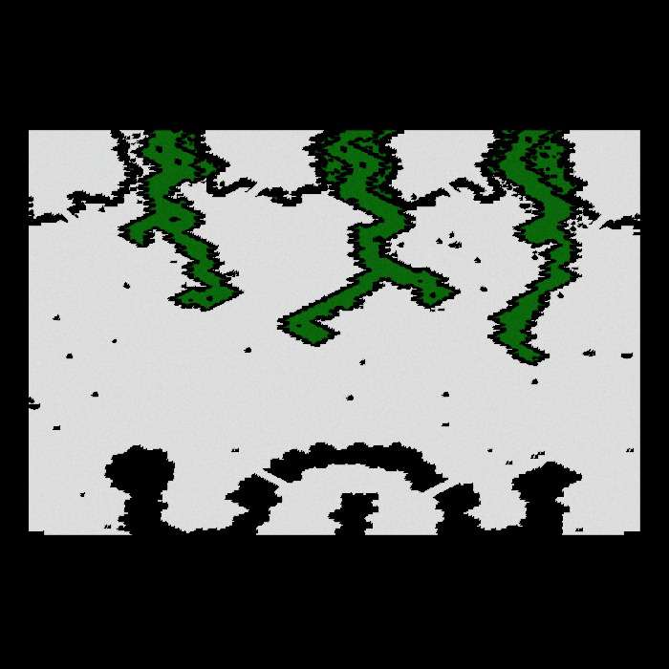
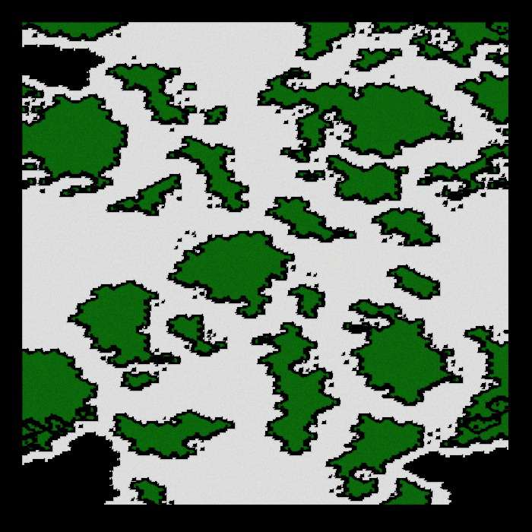
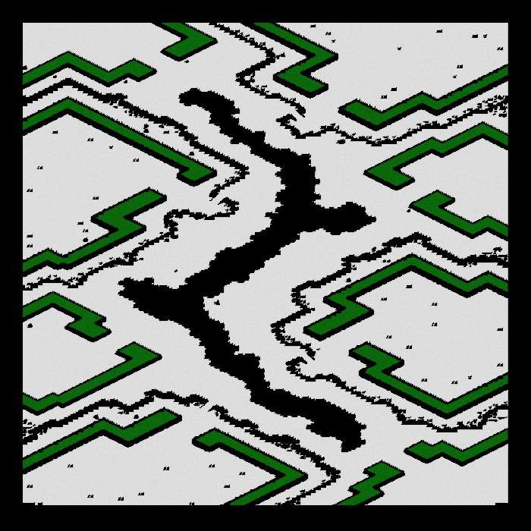
StarCraft Maps: JPS+ Goal Bounds

Slide 17
StarCraft Maps: Comparison
JPS+
Subgoal Graph
JPS+ Goal Bounds

Slide 18
StarCraft Maps: Comparison
JPS+
Subgoal Graph
JPS+ Goal Bounds

Slide 19
Goal Bounding
1 value
Per Edge
4 values
Per Edge
JPS+
Grids, NavMesh, Graphs
Fast O(n)
Precompute
Slow O(n²)
Precompute
No Map
Changes
Dijkstra, A*,
other algorithms
Uniform
Cost
Avoid
Redundant
Paths
Avoid
Wrong
Directions
Non-Uniform
Cost

Slide 20
Overview
JPS+ Preprocessing & Runtime
Goal Bounding Preprocessing & Runtime
Results and Analysis
Future Work

Slide 21
JPS+ Explained

Slide 22
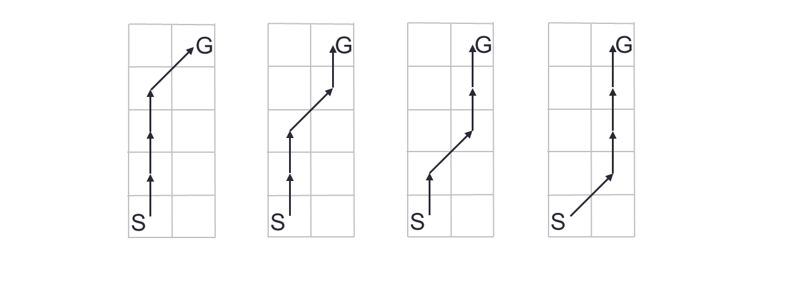
Equivalent Paths on Grids

Slide 23
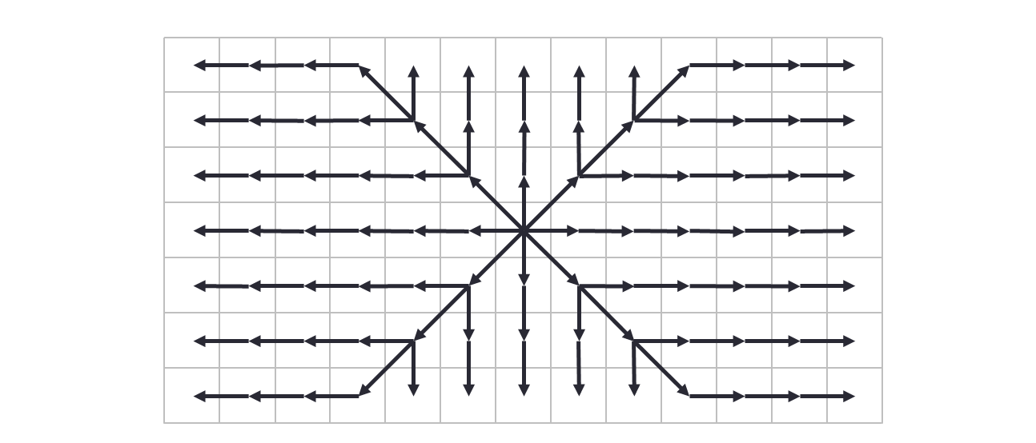
JPS Search Strategy

Slide 24
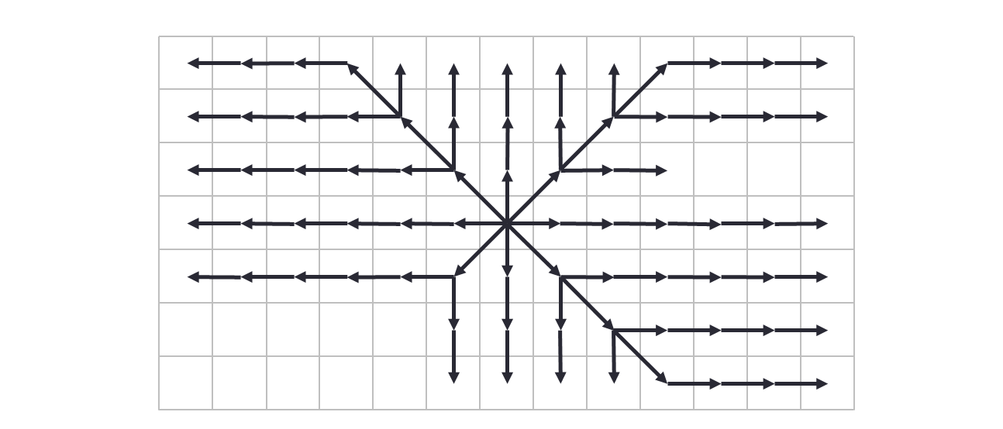
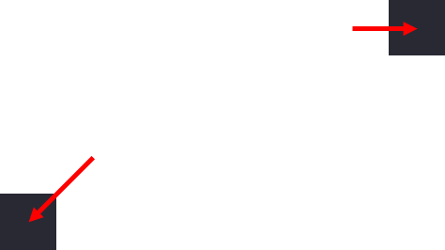
JPS Search Strategy

Slide 25
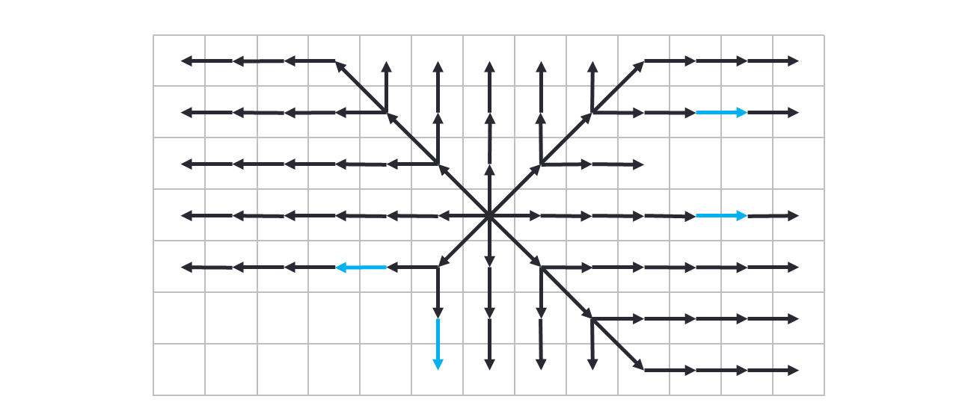

JPS Search Strategy

Slide 26
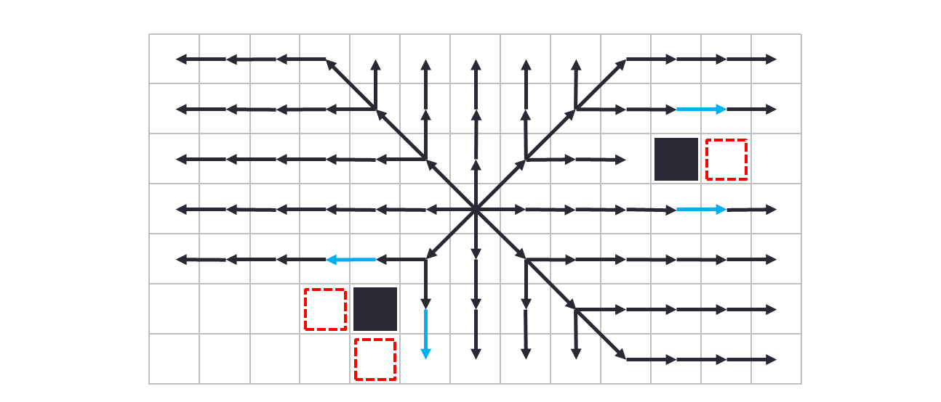
JPS Search Strategy

Slide 27
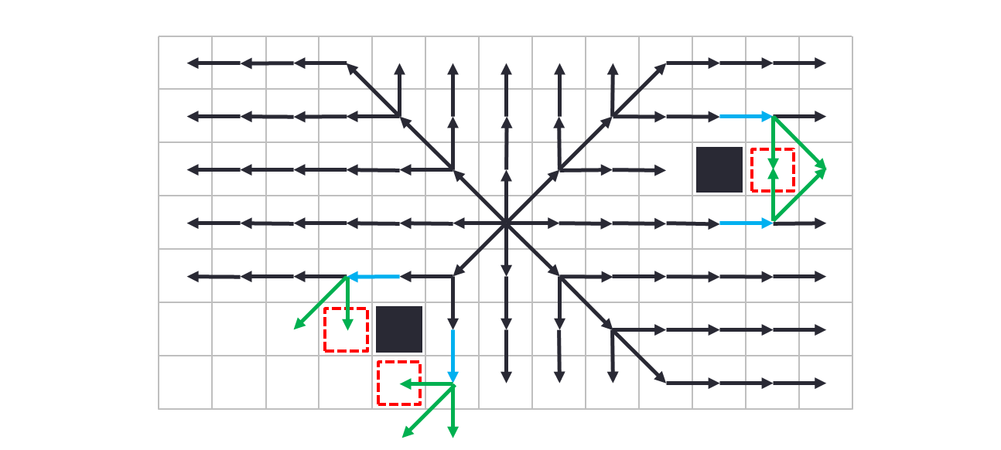
JPS Search Strategy

Slide 28
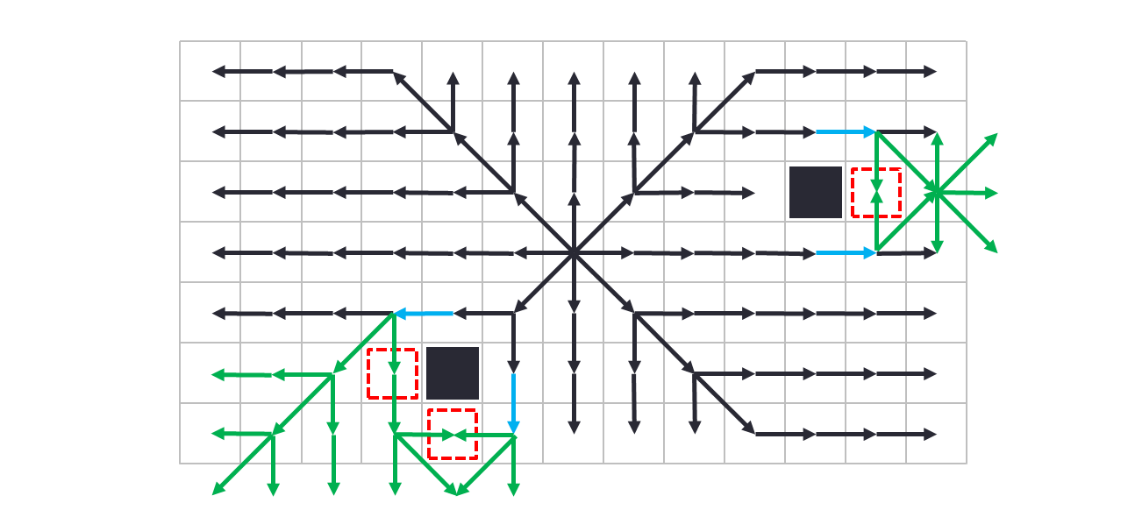
JPS Search Strategy

Slide 29
Forced Neighbor Cases

Slide 30
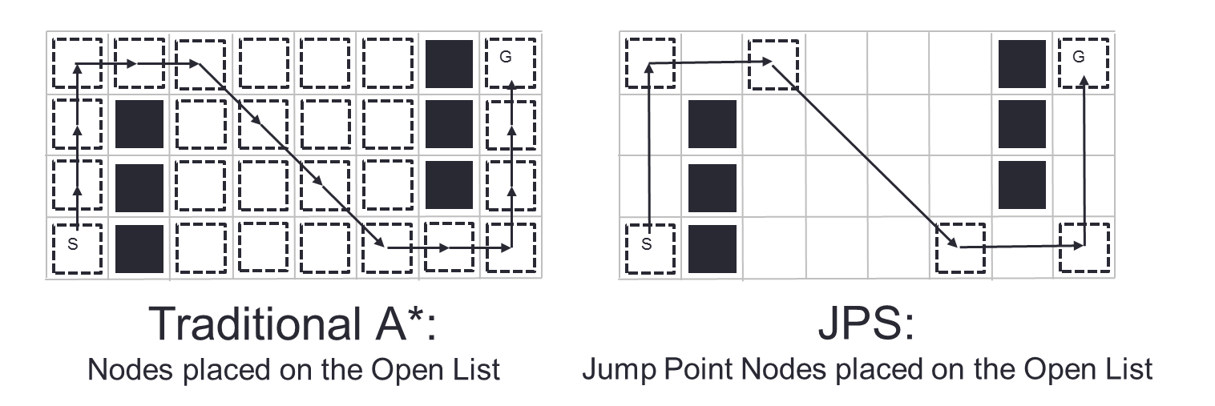
Fewer Open List Nodes

Slide 31
Four Types of Jump Points
Primary
Straight
Diagonal
Target

Slide 32
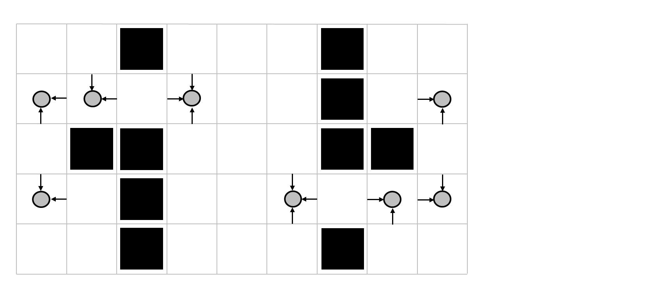
Primary Jump Points

Slide 33
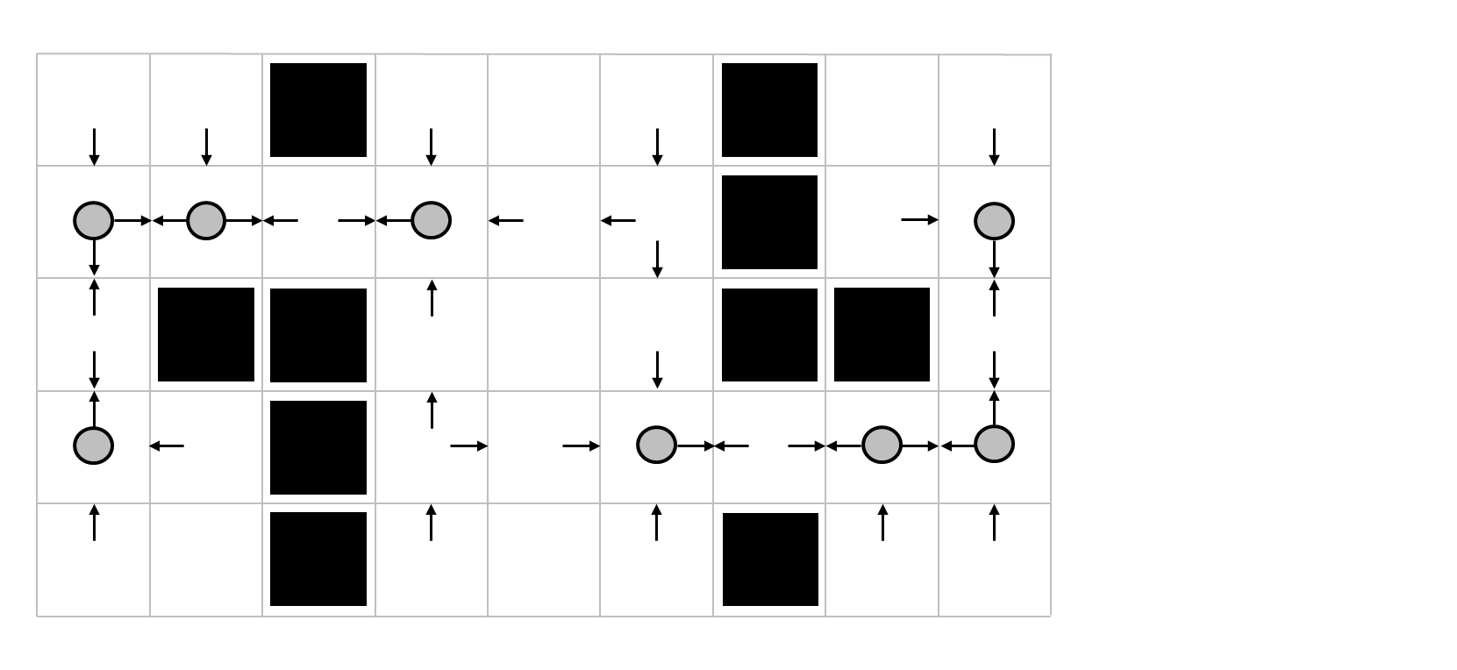
Straight Jump Points

Slide 34
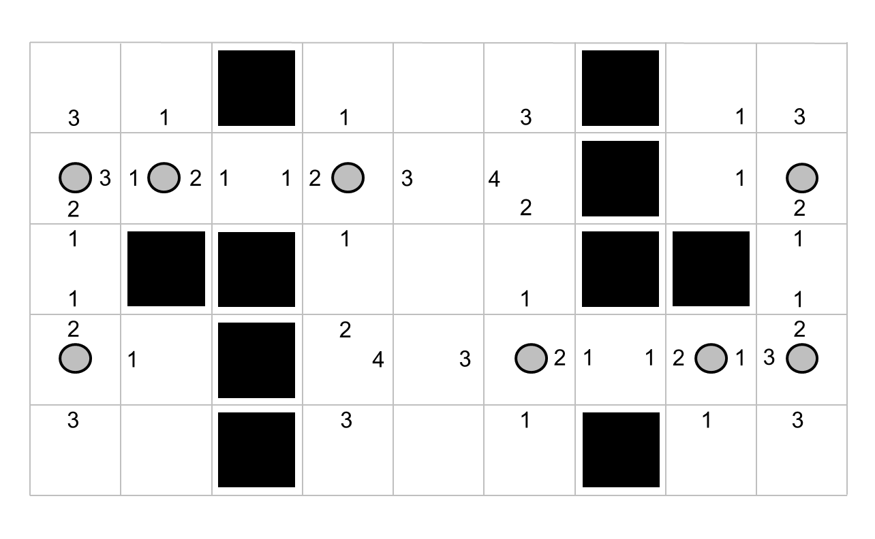
Straight Jump Point Distance

Slide 35
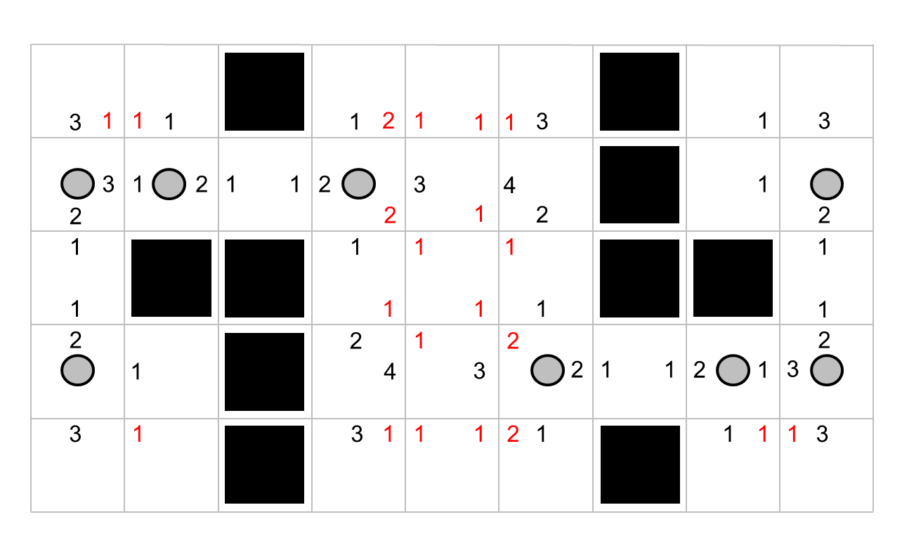
Diagonal Jump Points

Slide 36
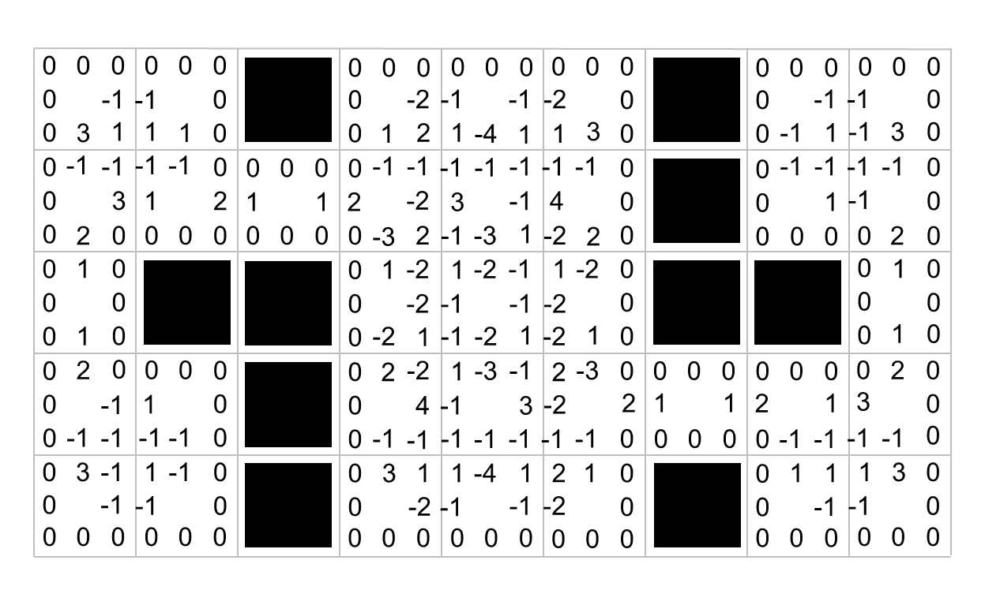
Add in Wall Distances (0 or neg)

Slide 37
Four Types of Jump Points
Primary
Straight
Diagonal
Target (runtime)

Slide 38
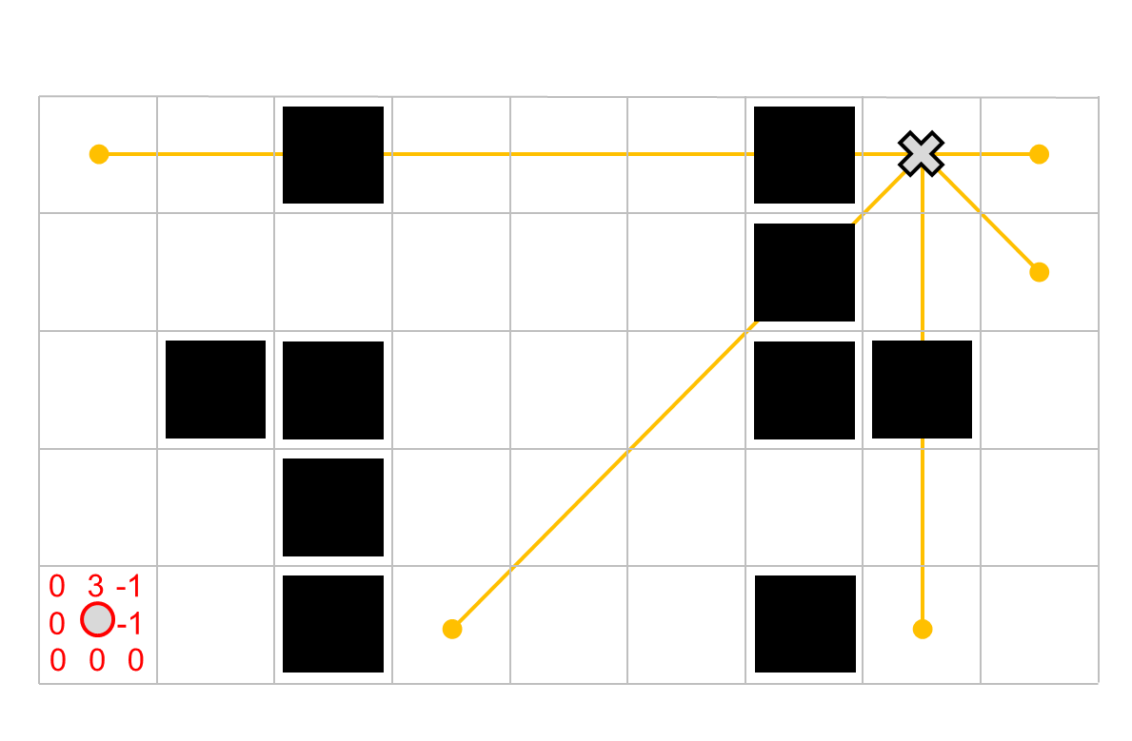
JPS+ Runtime Example

Slide 39
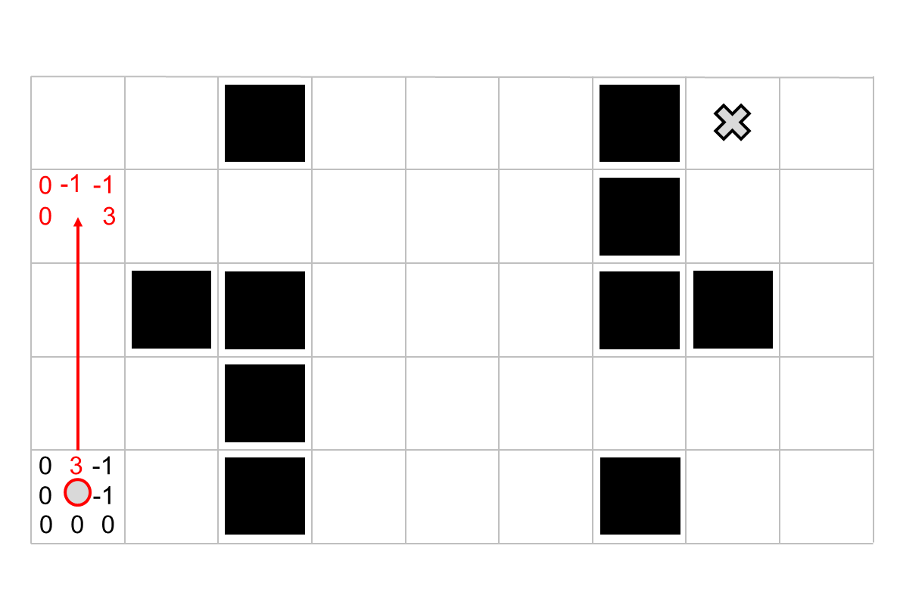

Slide 40
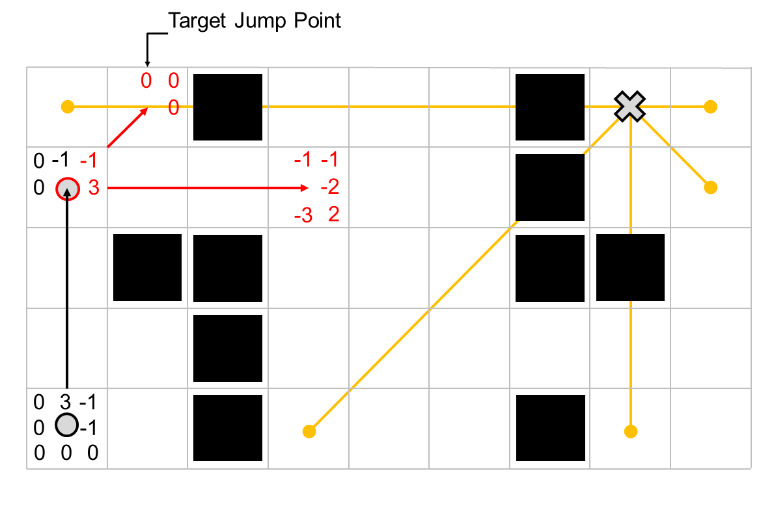

Slide 41
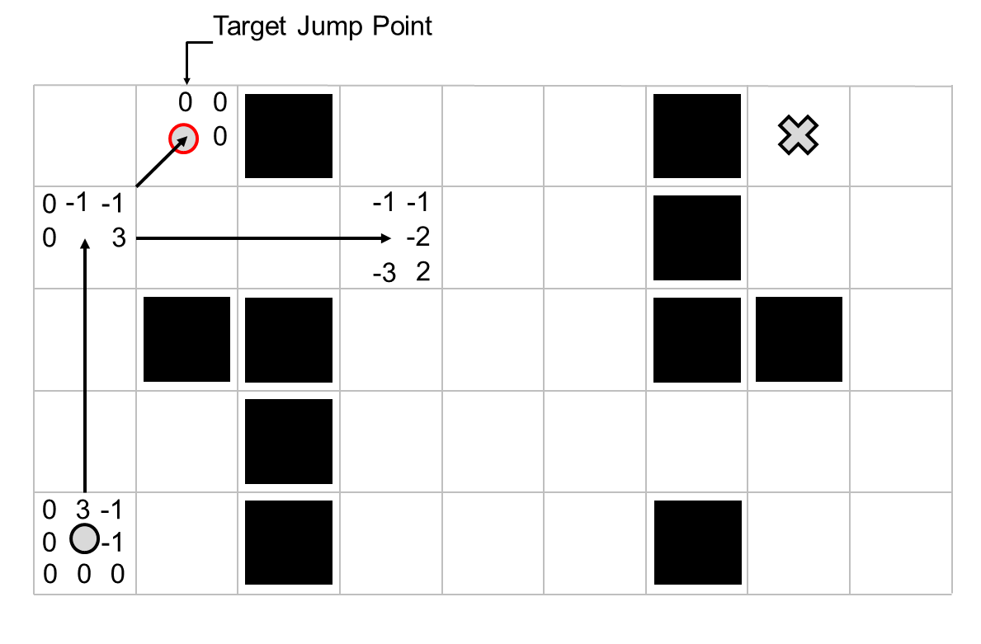

Slide 42
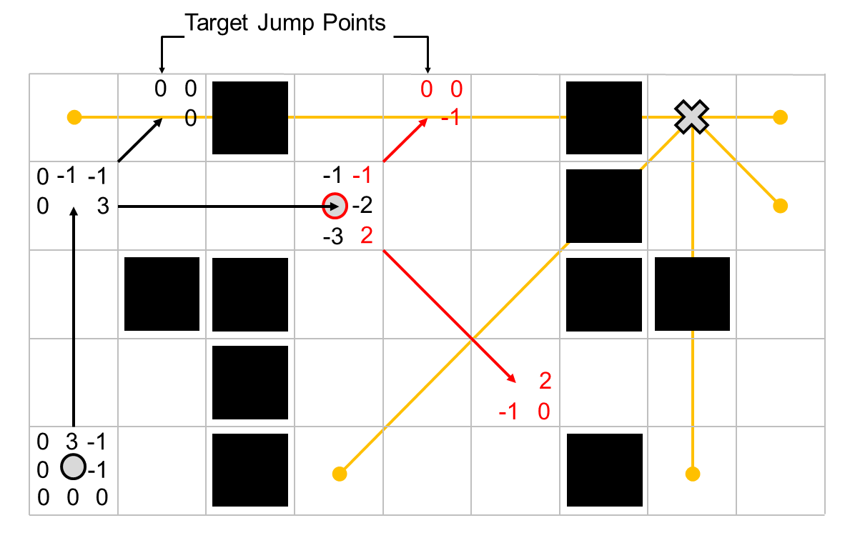

Slide 43
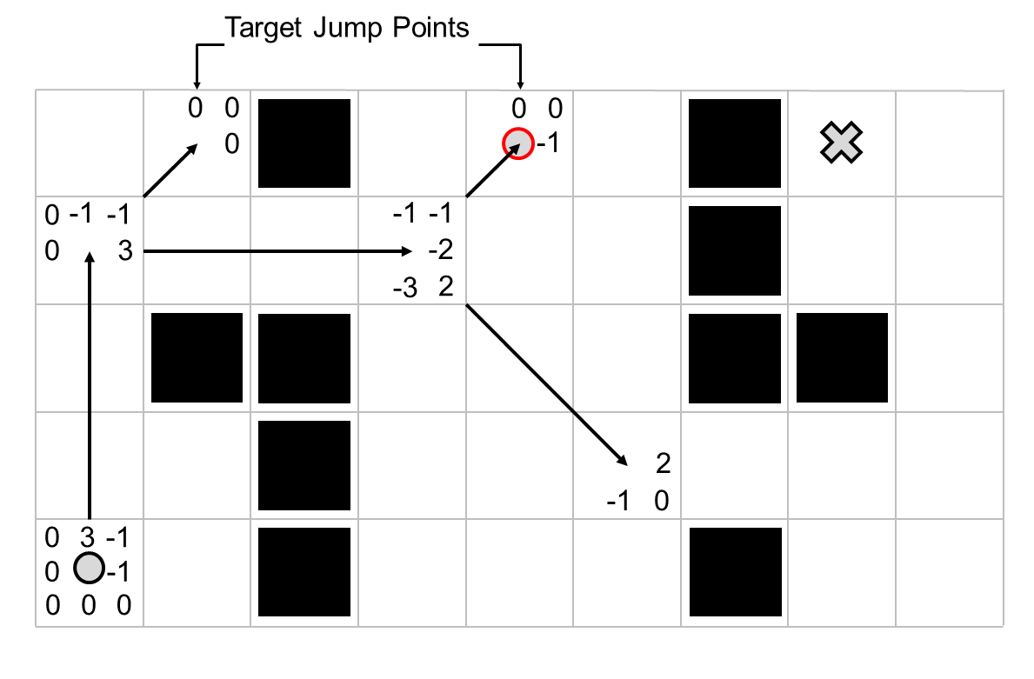

Slide 44
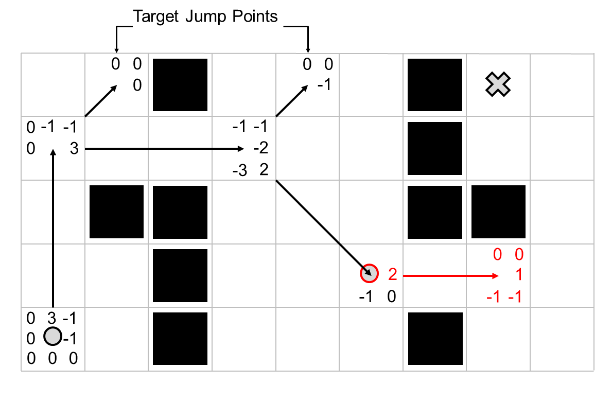

Slide 45
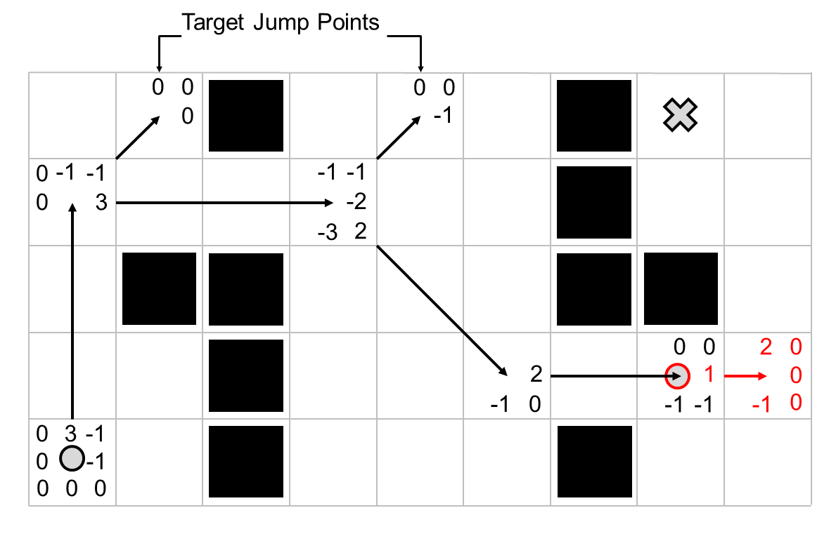

Slide 46
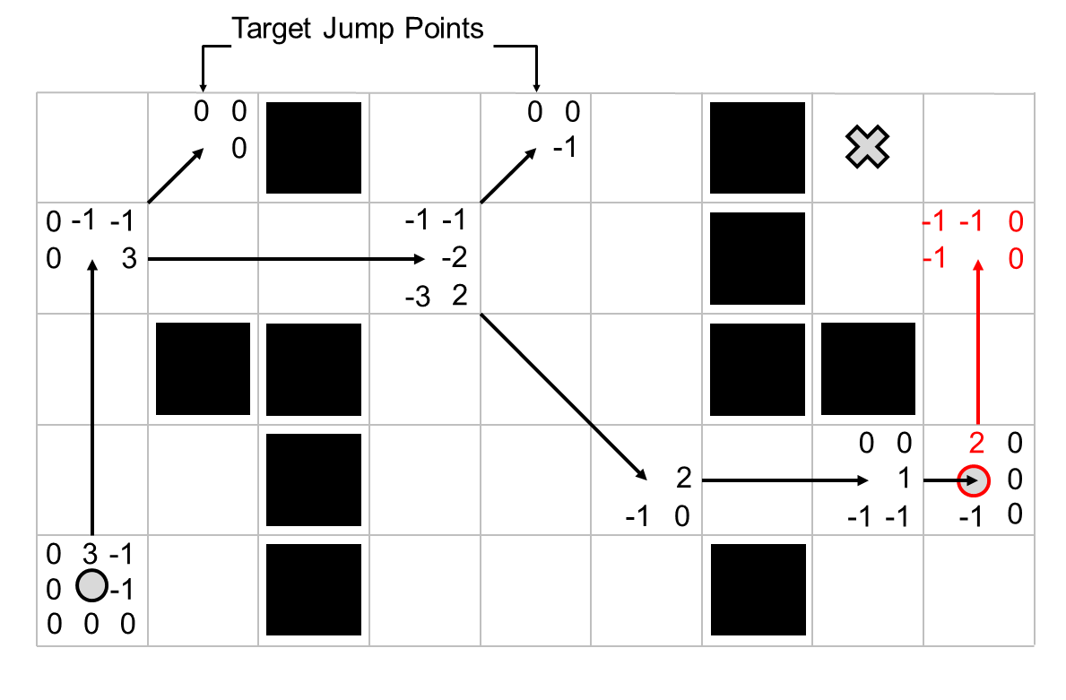

Slide 47
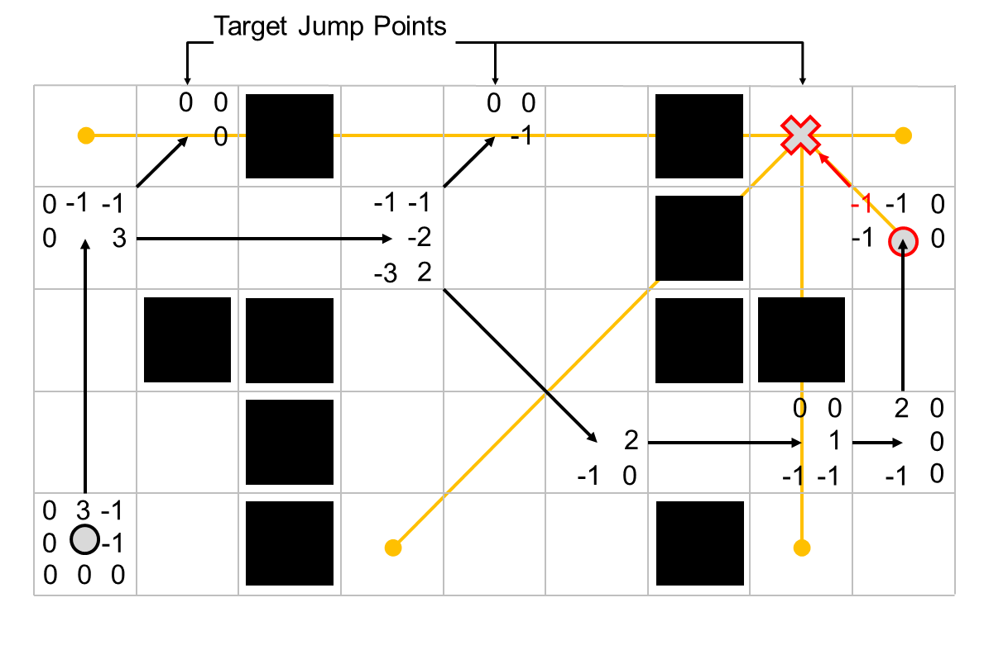

Slide 48
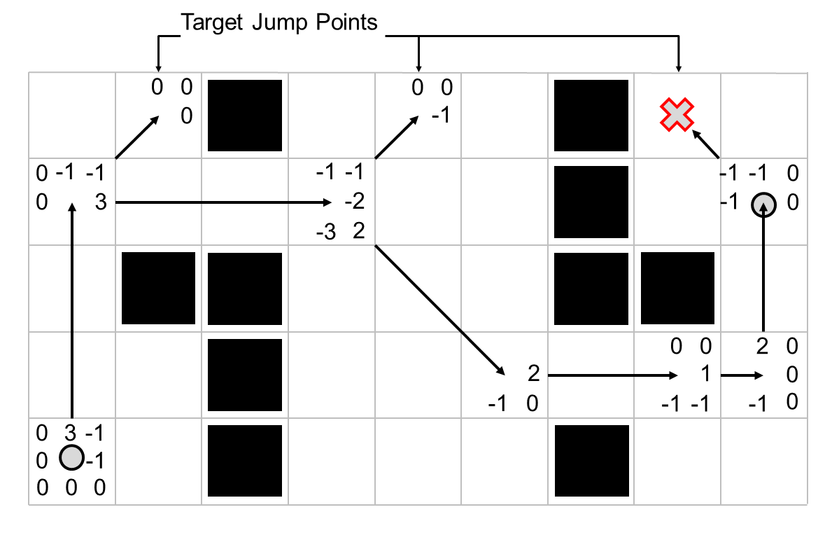

Slide 49
Goal Bounding

Slide 50
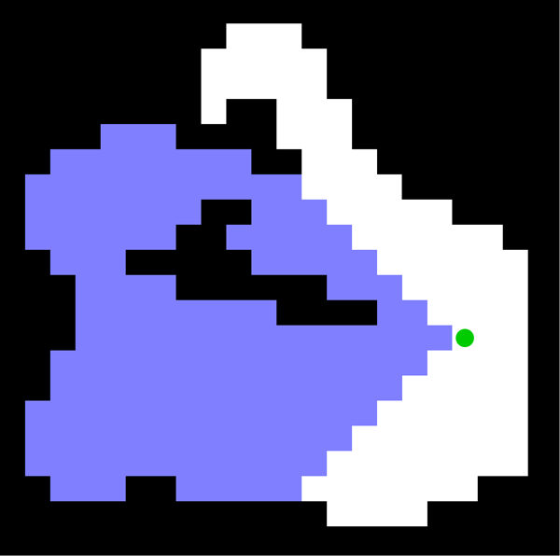
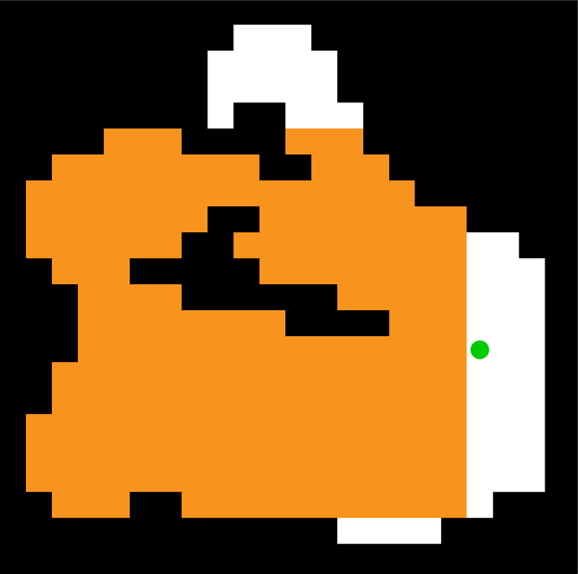
A* Search
Reachable optimally
by exploring left
Optimal goal bounds
when exploring left

Slide 51
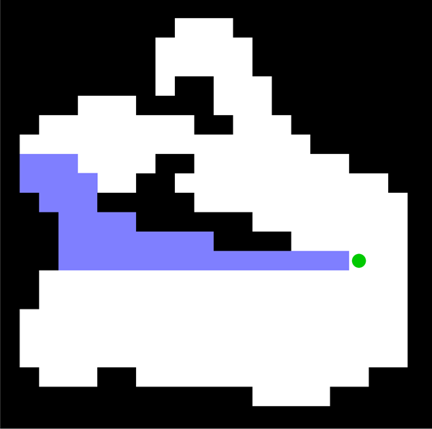

JPS+ Search
Reachable optimally
by exploring left
Optimal goal bounds
when exploring left

Slide 52
A* Search
Goal Bounds
JPS+ Search
Goal Bounds

Slide 53
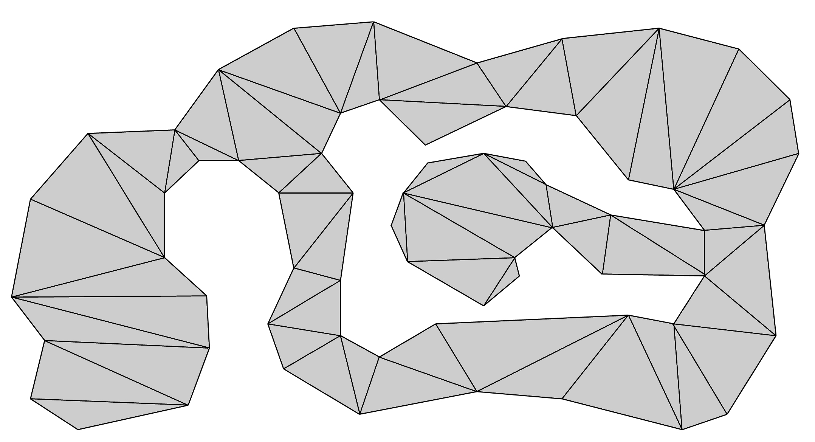
Goal Bounding
A* Search

Slide 54
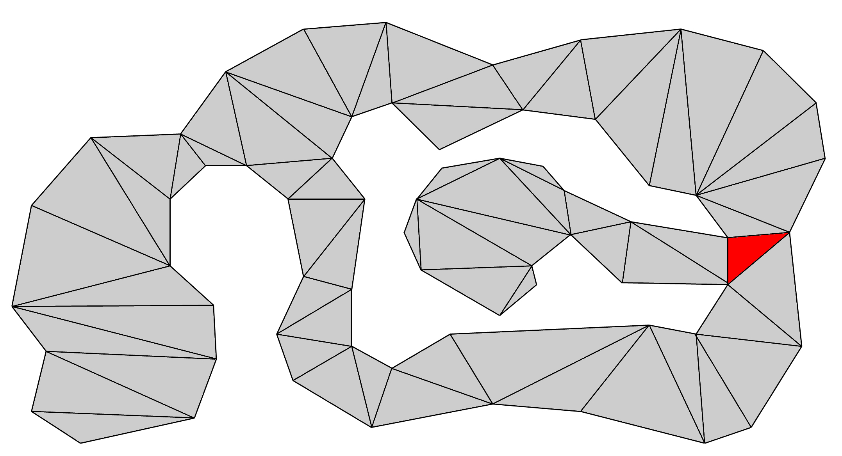
Goal Bounding
A* Search

Slide 55
Goal Bounding
A* Search

Slide 56
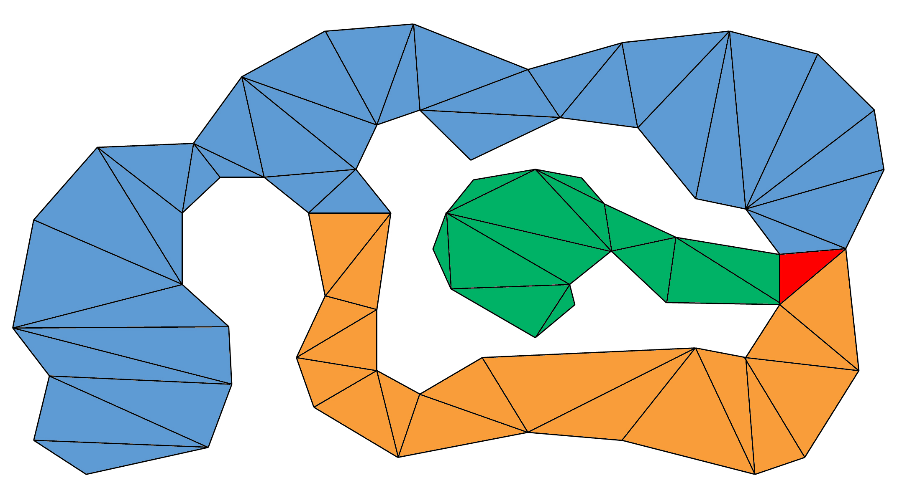
Goal Bounding
A* Search

Slide 57
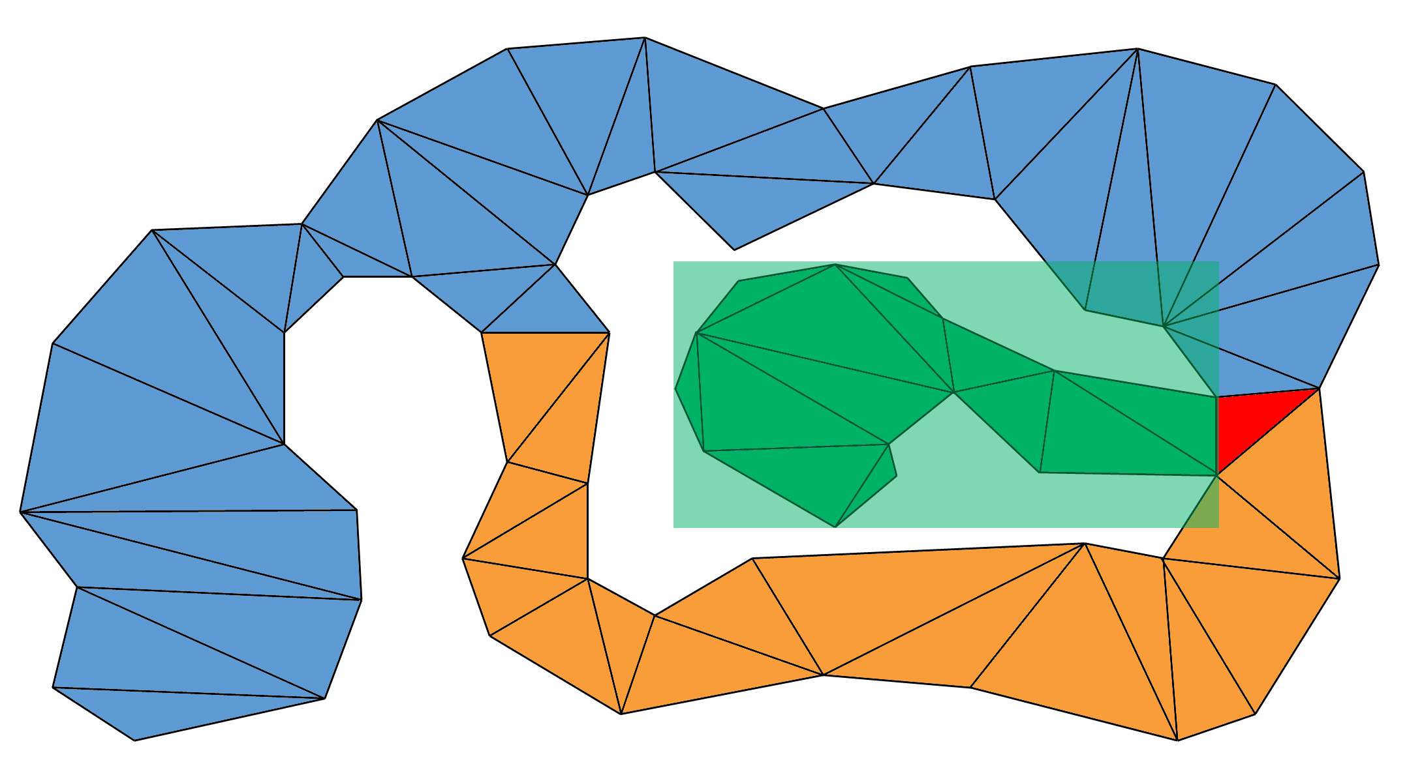
Goal Bounding
A* Search

Slide 58
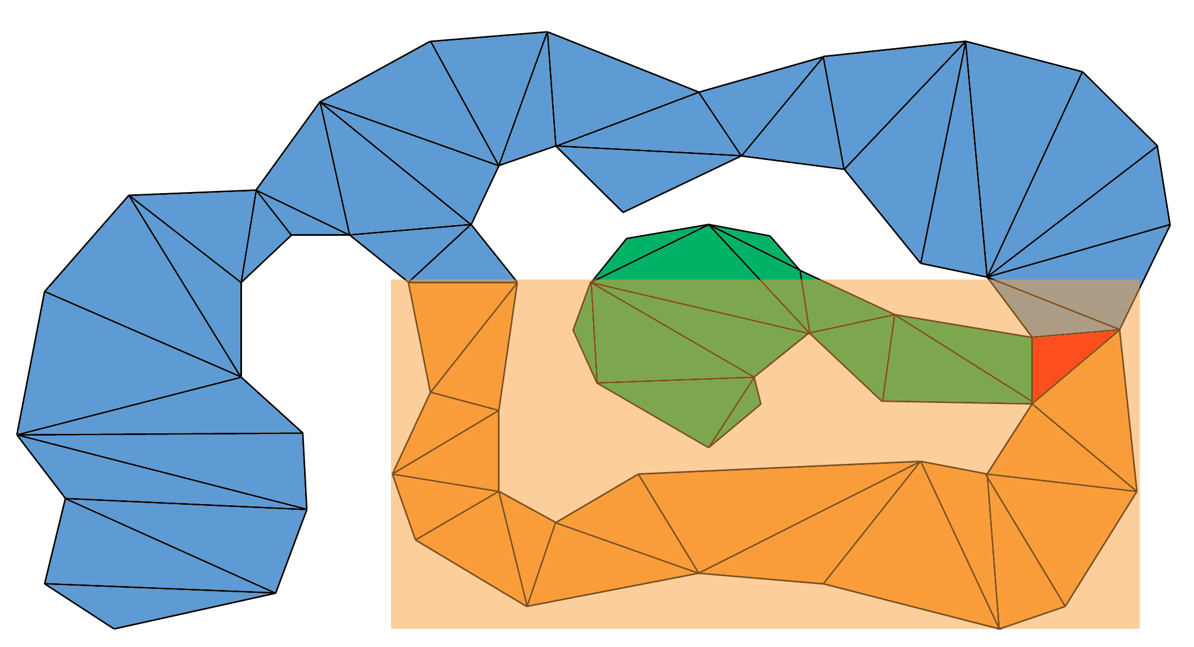
Goal Bounding
A* Search

Slide 59
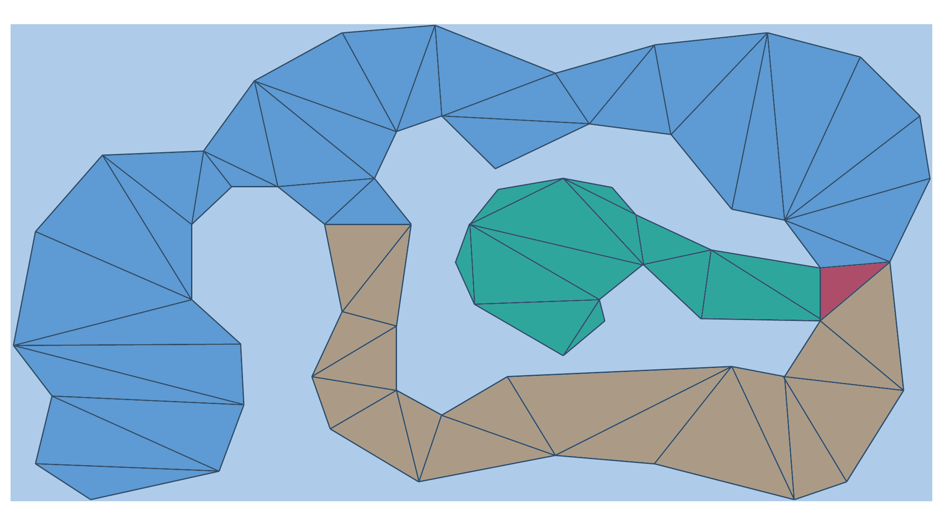
Goal Bounding
A* Search

Slide 60
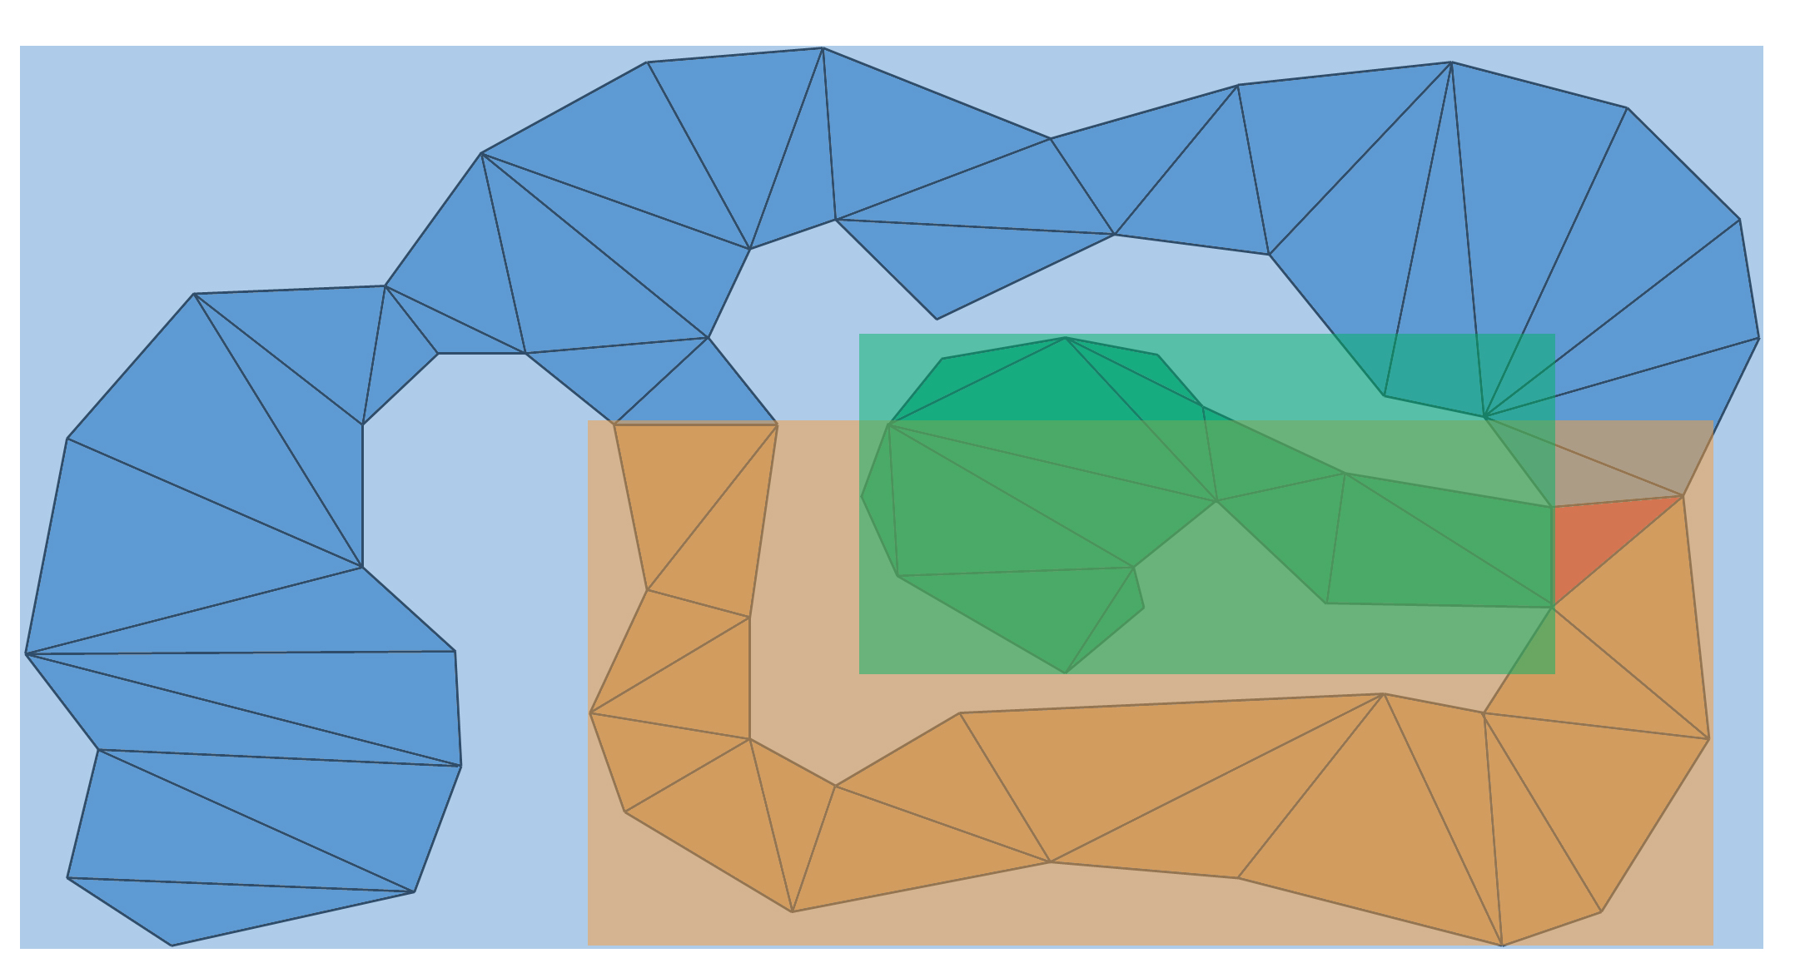
Goal Bounding
A* Search

Slide 61
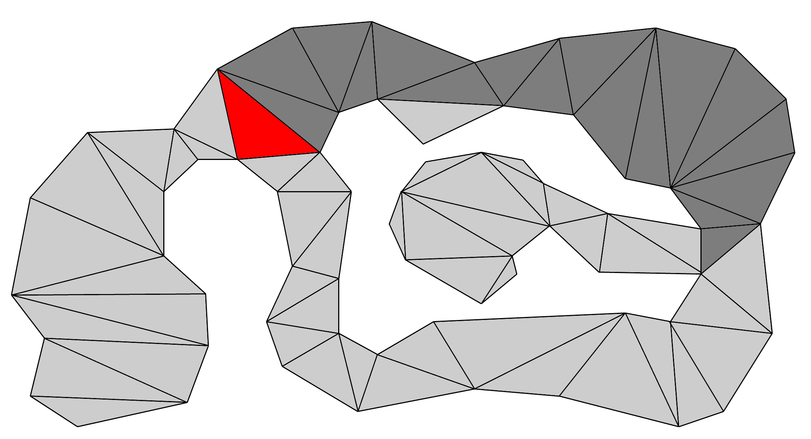
Goal Bounding
A* Search

Slide 62
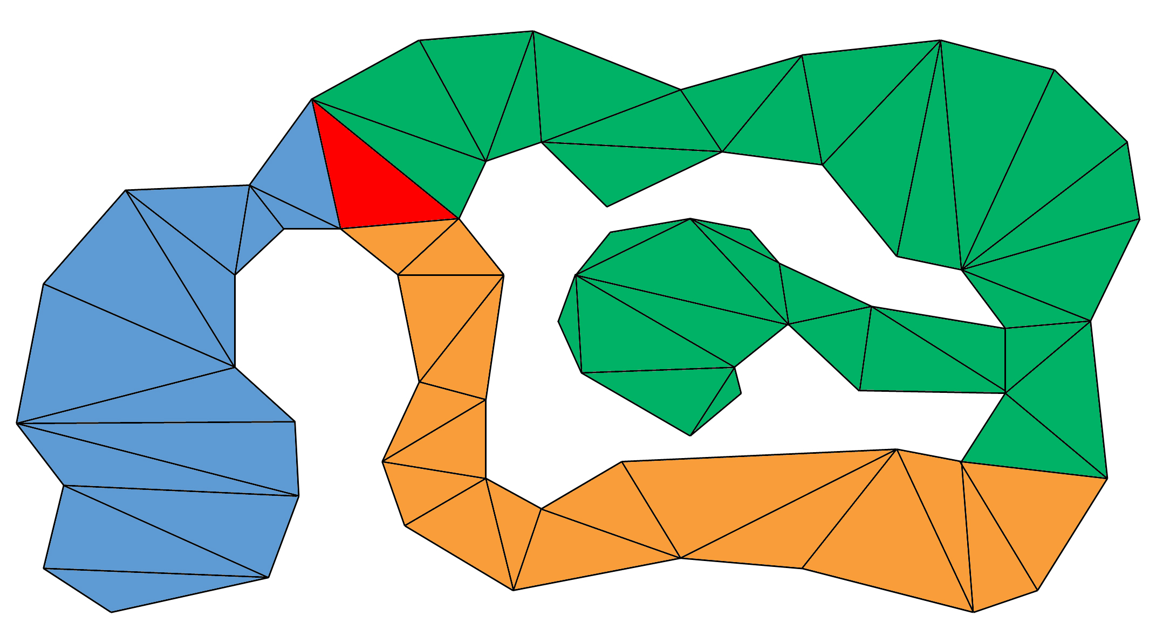
Goal Bounding
A* Search

Slide 63
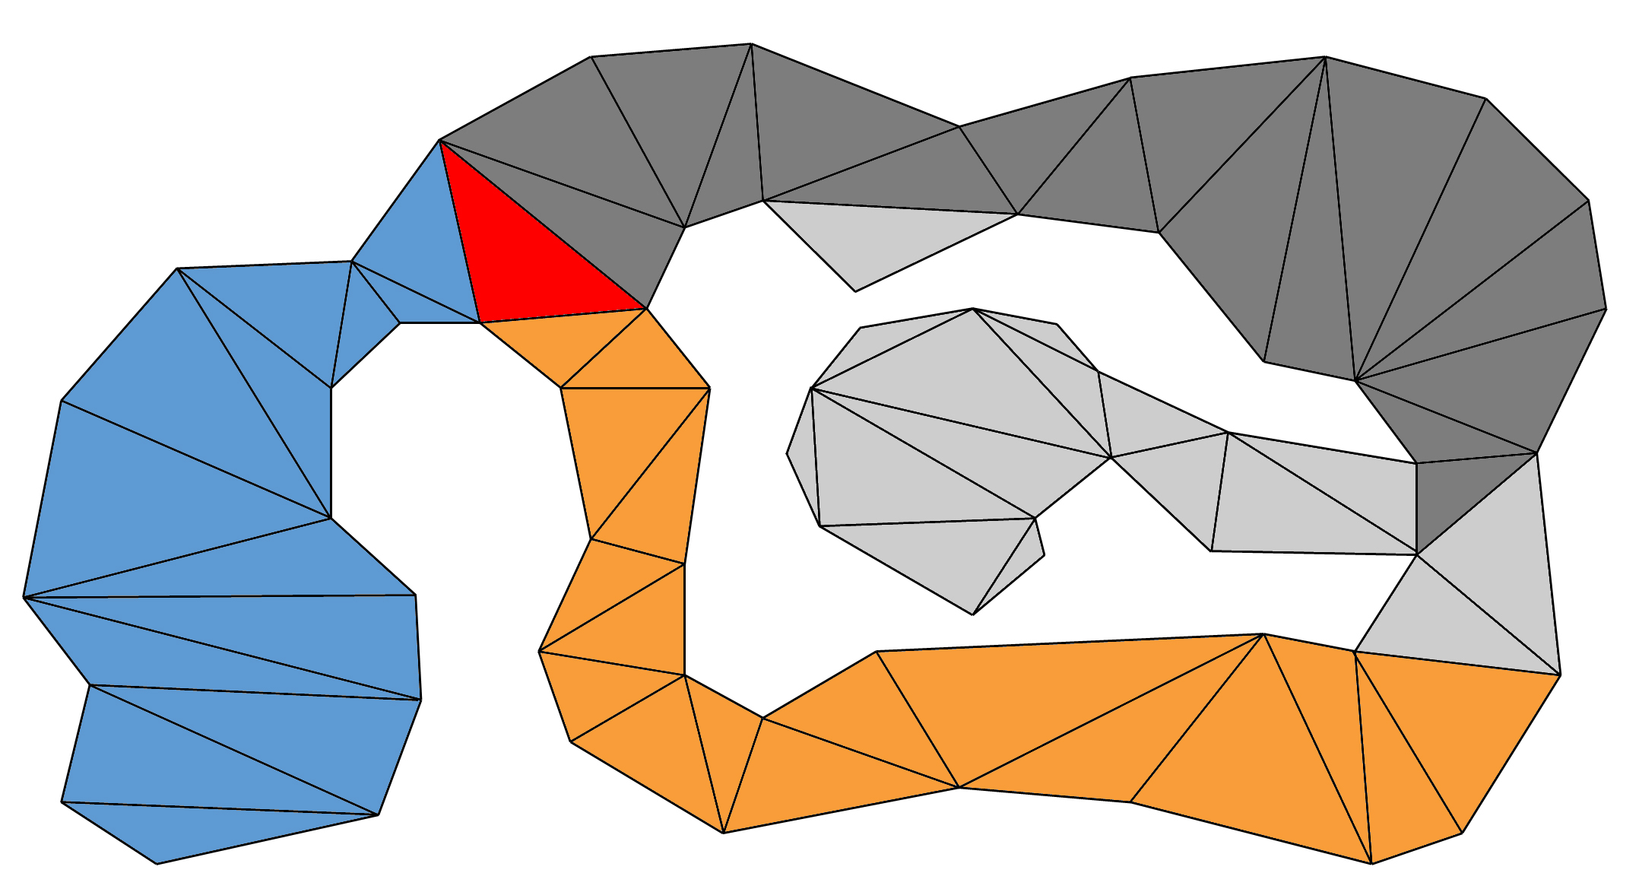
Goal Bounding
A* Search

Slide 64
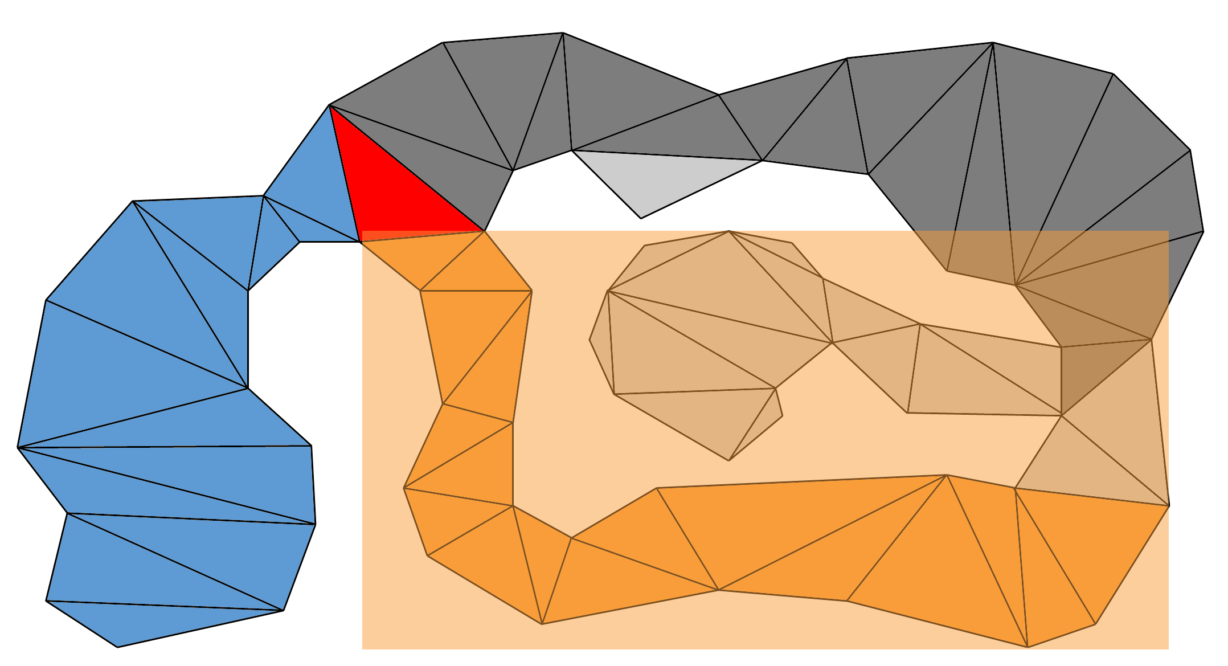
Goal Bounding
A* Search

Slide 65

Goal Bounding
A* Search

Slide 67


Slide 68
How to calculate Goal Bounds
Dijkstra floodfill from each node
When you put a node on the Closed list
Update start node’s Goal Bounds
(for the edge it originally came from!)
Embarrassingly parallel

Slide 69
Calculating
Goal Bounds

Slide 70

Calculating
Goal Bounds

Slide 71

Calculating
Goal Bounds

Slide 72
Calculating
Goal Bounds

Slide 73
Calculating
Goal Bounds

Slide 74
Calculating
Goal Bounds

Slide 75
Calculating
Goal Bounds

Slide 76
Calculating
Goal Bounds

Slide 77
Calculating
Goal Bounds

Slide 78
Calculating
Goal Bounds

Slide 79
Calculating
Goal Bounds

Slide 80
Calculating
Goal Bounds

Slide 81
Calculating
Goal Bounds

Slide 82

Calculating
Goal Bounds

Slide 83

Calculating
Goal Bounds

Slide 84
Calculating
Goal Bounds

Slide 85
Calculating
Goal Bounds

Slide 86
Calculating
Goal Bounds

Slide 87
Calculating
Goal Bounds

Slide 88
Calculating
Goal Bounds

Slide 89
Calculating
Goal Bounds

Slide 90
Calculating
Goal Bounds

Slide 91
Calculating
Goal Bounds

Slide 92
Calculating
Goal Bounds

Slide 93
Calculating
Goal Bounds

Slide 94
Calculating
Goal Bounds

Slide 95
Calculating
Goal Bounds

Slide 96
Calculating
Goal Bounds

Slide 97
Calculating
Goal Bounds

Slide 98
Calculating
Goal Bounds

Slide 99
Calculating
Goal Bounds

Slide 100
Calculating
Goal Bounds

Slide 101
Calculating
Goal Bounds

Slide 102
Calculating
Goal Bounds

Slide 103
Calculating
Goal Bounds

Slide 104
Calculating
Goal Bounds

Slide 105
Calculating
Goal Bounds

Slide 106
Calculating
Goal Bounds

Slide 107
Calculating
Goal Bounds

Slide 108

Calculating
Goal Bounds

Slide 109

Calculating
Goal Bounds

Slide 110

Calculating
Goal Bounds

Slide 111

Calculating
Goal Bounds

Slide 112

Calculating
Goal Bounds

Slide 113
Optimizations

Slide 114
JPS+ Goal Bounding
Fast stack and unsorted Open list
Only works for grids using Octile heuristic

Slide 115

Across the Cape (768x768)
2940 tests
From 4.41 to 1176.61
Search | Max Open List Size | Avg Size On PopCheapest
A*
JPS+ GB

Slide 116
Across the Cape (768x768)
2940 tests
From 4.41 to 1176.61
Search | Max Open List Size | Avg Size On PopCheapest
A* | 3464
JPS+ GB

Slide 117
Across the Cape (768x768)
2940 tests
From 4.41 to 1176.61
Search | Max Open List Size | Avg Size On PopCheapest
A* | 3464 | 1204
JPS+ GB

Slide 118
Across the Cape (768x768)
2940 tests
From 4.41 to 1176.61
Search | Max Open List Size | Avg Size On PopCheapest
A* | 3464 | 1204
JPS+ GB | 11

Slide 119
Across the Cape (768x768)
2940 tests
From 4.41 to 1176.61
Search | Max Open List Size | Avg Size On PopCheapest
A* | 3464 | 1204
JPS+ GB | 11 | 3
3711x faster than A*

Slide 120
Arctic Station (768x768)
4100 tests
From 4 to 1643.06 long
Search | Max Open List Size | Avg Size On PopCheapest
A*
JPS+ GB

Slide 121
Arctic Station (768x768)
4100 tests
From 4 to 1643.06 long
Search | Max Open List Size | Avg Size On PopCheapest
A* | 4373 | 1154
JPS+ GB

Slide 122
Arctic Station (768x768)
4100 tests
From 4 to 1643.06 long
Search | Max Open List Size | Avg Size On PopCheapest
A* | 4373 | 1154
JPS+ GB | 8 | 1
4907x faster than A*

Slide 123
JPS+ Goal Bounding
Function pointer table
256 wall permutations X 8 parent directions
2048 look-up table pointing at 42 functions

Slide 124
Problem: Dynamic Maps

Slide 125
Goal Bounding
Gates

Slide 126
Goal Bounding
Gates

Slide 127
Goal Bounding
Gates

Slide 128
Recap

Slide 129
Goal Bounding
JPS+
70x to 350x
faster
1400x to 5000x
faster
20x to 60x
faster
Avoid
Redundant
Paths
Avoid
Wrong
Directions

Slide 130
Goal Bounding
1 value
Per Edge
4 values
Per Edge
JPS+
Grids, NavMesh, Graphs
Fast O(n)
Precompute
Slow O(n²)
Precompute
No Map
Changes
Dijkstra, A*,
other algorithms
Uniform
Cost
Avoid
Redundant
Paths
Avoid
Wrong
Directions
Non-Uniform
Cost

Slide 131
StarCraft Maps: Comparison
JPS+
Subgoal Graph
JPS+ Goal Bounds

Slide 132
Future Work
Can Goal Bounding work with Subgoal?
Can the precompute be done in O(n)?
Are there better bounds than a box?
How much does it actually speed up A* on a NavMesh?

Slide 133
Questions?
steve.rabin@gmail.com
Email me for source code
Slides at:
www.gameaipro.com

